Slide 1

CS 410 / CS 560: Software Engineering
Software Life Cycle
Dr. Mohammed Ayoub Alaoui Mhamdi
Bishop's University
Sherbrooke, Qc, Canada
malaoui@ubishops.ca

Slide 2
Main issues
Discussion of different life cycle models
Maintenance or evolution

Slide 3
Introduction
software development projects are large and complex
a phased approach to control it is necessary
traditional models are document-driven: there is a new pile of paper after each phase is completed
  They assume that software development proceeds in an orderly, sequential manner,
  The pile of paper that is produced in the course of the project guides the development process
  evolutionary models recognize that much of what is called maintenance is inevitable
latest fashion: agile methods, eXtreme Programming
life cycle models can be explicitly modeled, in a process modeling language

Slide 4
Simple life cycle model
problem
requirements engineering
reqs specification
design
design
implementation
system
testing
working system
maintenance

Slide 5
Simple life cycle model
software development projects are large and complex
a phased approach to control it is necessary
traditional models are document-driven: there is a new pile of paper after each phase is completed
  They assume that software development proceeds in an orderly, sequential manner.
  evolutionary models recognize that much of what is called maintenance is inevitable
latest fashion: agile methods, eXtreme Programming
life cycle models can be explicitly modeled, in a process modeling language

Slide 6
Point to ponder #1
Why does the model look like this?
Is this how we go about?

Slide 7
Simple Life Cycle Model
document driven, planning driven, heavyweight
milestones are reached if the appropriate documentation is delivered (e.g., requirements specification, design specification, program, test document)
much planning upfront, often heavy contracts are signed
problems
  feedback is not taken into account
  maintenance does not imply evolution

Slide 8
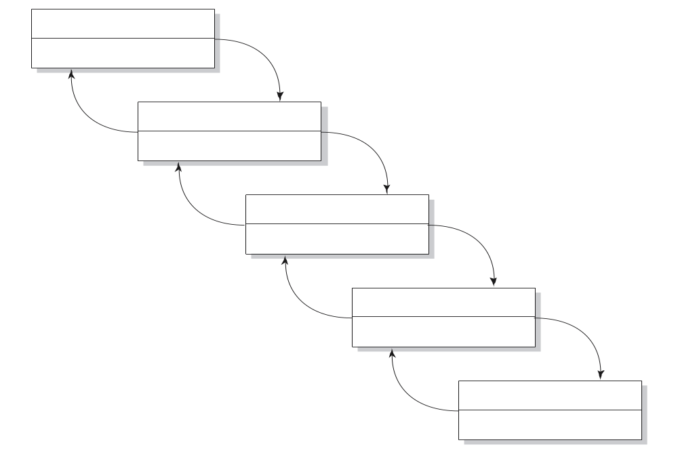
Waterfall Model
reqs engineering
V & V
design
V & V
implementation
V & V
testing
V & V
maintenance
V & V

Slide 9
V-Model
reqs eng
acceptance
testing
global design
integration
testing
det. design
unit testing
coding

Slide 10
Waterfall Model
includes iteration and feedback
validation (are we building the right system?) and verification (are we building the system right?) after each step
user requirements are fixed as early as possible
problems
  too rigid
  developers cannot move between various abstraction levels

Slide 11
Activity versus phase
Implementation
Integration
testing
Acceptance
testing
Phase
Design
Activity
Integration
testing
4.7
43.4
26.1
25.8
Implementation
(& unit testing)
6.9
70.3
15.9
6.9
Design
49.2
34.1
10.3
6.4

Slide 12

Lightweight (agile) approaches
prototyping
incremental development
XP

Slide 13

The Agile Manifesto
Individuals and interactions over processes and tools
Working software over comprehensive documentation
Customer collaboration over contract negotiation
Responding to change over following a plan

Slide 14
Prototyping
requirements elicitation is difficult
  software is developed because the present situation is unsatisfactory
  however, the desirable new situation is as yet unknown
prototyping is used to obtain the requirements of some aspects of the system
prototyping should be a relatively cheap process
  use rapid prototyping languages and tools
  not all functionality needs to be implemented
  production quality is not required

Slide 15
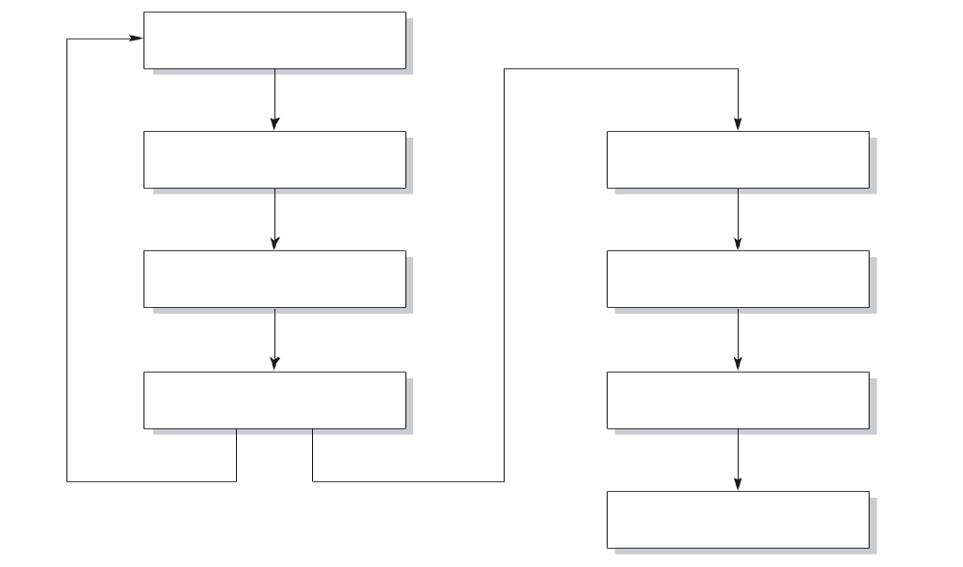
Prototyping as a tool for requirements engineering
reqs engineering
design
design
implementation
implementation
testing
testing
maintenance

Slide 16
Prototyping
throwaway prototyping: the n-th prototype is followed by a waterfall-like process (as depicted on previous slide)
  creation of a model that will eventually be discarded rather than becoming part of the final delivered software.
evolutionary prototyping: the nth prototype is delivered
  is a lifecycle model in which the system is developed in increments so that it can readily be modified in response to end-user and customer feedback.

Slide 17
Point to ponder #2
What are the pros and cons of the two approaches?

Slide 18
Prototyping, advantages
The resulting system is easier to use
User needs are better accommodated
The resulting system has fewer features
Problems are detected earlier
The design is of higher quality
The resulting system is easier to maintain
The development incurs less effort

Slide 19
Prototyping, disadvantages
The resulting system has less features
The performance of the resulting system is worse
The design is of less quality
The resulting system is harder to maintain
The prototyping approach requires more experienced team members

Slide 20
Prototyping, recommendations
the users and the designers must be well aware of the issues and the pitfalls
use prototyping when the requirements are unclear
prototyping needs to be planned and controlled as well

Slide 21
Incremental Development
a software system is delivered in small increments, thereby avoiding the Big Bang effect
the waterfall model is employed in each phase
the user is closely involved in directing the next steps
incremental development prevents overfunctionality

Slide 22
XP – eXtreme Programming
Everything is done in small steps
The system always compiles, always runs
Client as the center of development team
Developers have same responsibility w.r.t. software and methodology

Slide 23
13 practices of XP
Whole team: client part of the team
Metaphor: common analogy for the system
The planning game, based on user stories
Simple design
Small releases (e.g. 2 weeks)
Customer tests
Pair programming
Test-driven development: tests developed first
Design improvement (refactoring)
Collective code ownership
Continuous integration: system always runs
Sustainable pace: no overtime
Coding standards

Slide 24
Maintenance or Evolution
some observations
  systems are not built from scratch
  there is time pressure on maintenance
the five laws of software evolution
  law of continuing change
  law of increasingly complexity
  law of program evolution
  law of invariant work rate
  law of incremental growth limit

Slide 25
Purposes of process modeling
facilitates understanding and communication by providing a shared view of the process
supports management and improvement; it can be used to assign tasks, track progress, and identify trouble spots
serves as a basis for automated support (usually not fully automatic)

Slide 26
Caveats of process modeling
not all aspects of software development can be caught in an algorithm
a model is a model, thus a simplification of reality
progression of stages differs from what is actually done
some processes (e.g. learning the domain) tend to be ignored
no support for transfer across projects

Slide 27
Summary
Traditional models focus on control of the process
There is no one-size-fits-all model; each situation requires its own approach
A pure project approach inhibits reuse and maintenance
There has been quite some attention for process modeling, and tools based on such process models

